Slide 1
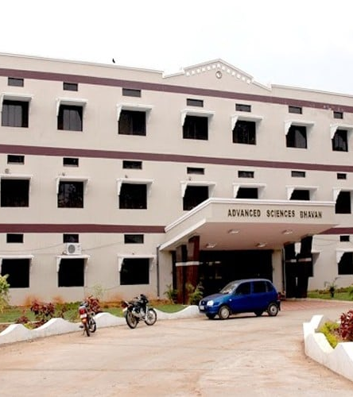
WELCOME TO NAAC PEER TEAM
Department of Human Genetics
Andhra University
Visakhapatnam

Slide 2
Human Genetics Department Profile
Established in the year 1972, for the first time in the country.
The Department was headed by eminent Professors
Thrust area in research is on Sickle Cell Anemia.
For the past four decades the Department is rendering services in diagnosing Sickle Cell cases referred primarily from KGH

Slide 3
Vision
To be a leader in genetics education, research, and community healthcare, making profound contributions to human health and scientific understanding
Mission
To empower students by equipping them with a strong foundation in genetics, cutting-edge research skills, and an understanding of the ethical implications of genetic advancements.
To conduct interdisciplinary research that spans from basic genetics to applied genomics, with a focus on translating discoveries into innovative solutions for healthcare
To proactively connect with local communities to promote genetic literacy and to provide genetic services that improve health outcomes and quality of life.
To actively engage in public outreach, host conferences, and publish research to ensure that the latest genetic insights are accessible to all.

Slide 4
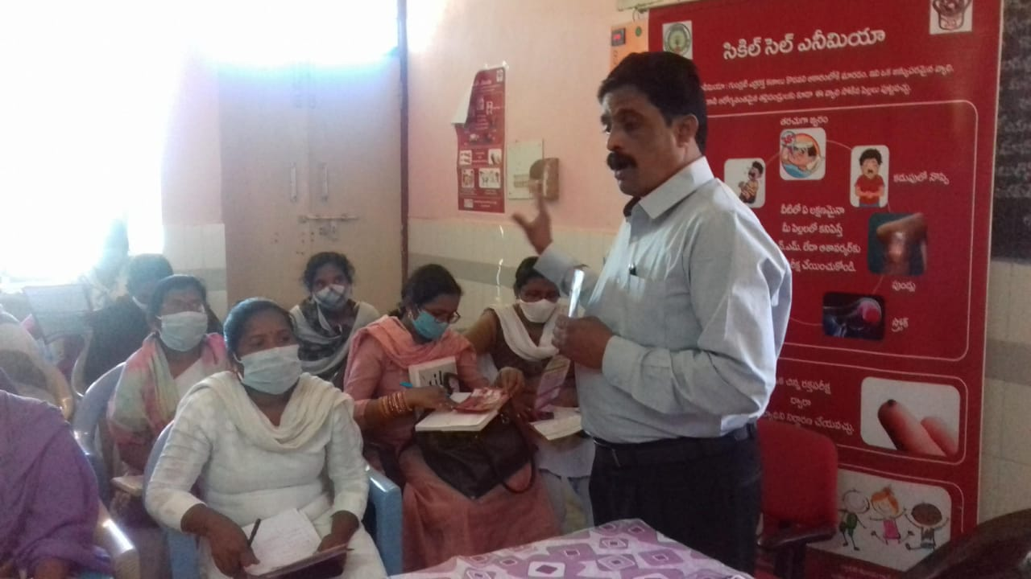
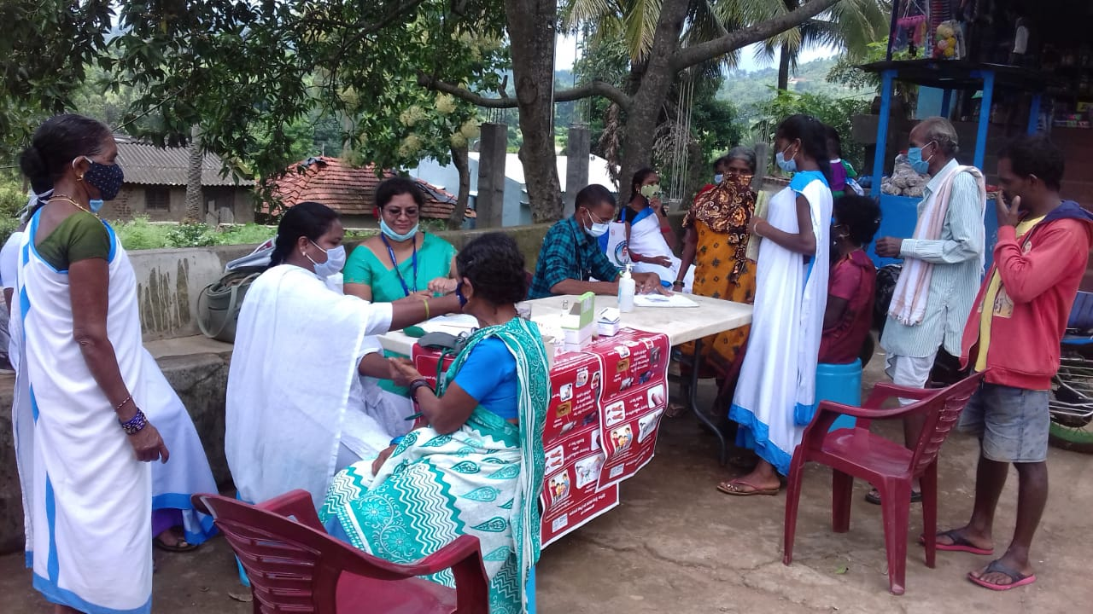
Completed Projects
Taskforce Project, “Improving the Capacity of Health System and Community for Sickle Cell Disease Screening and Management: An Intervention Study in Visakhapatnam District, Andhra Pradesh.
80 Lakhs, Funded by ICMR, New Delhi.
Training Health care workers
Screening the population

Slide 5
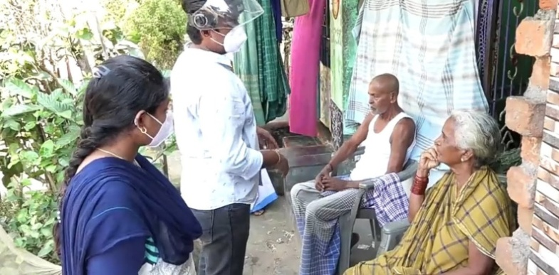
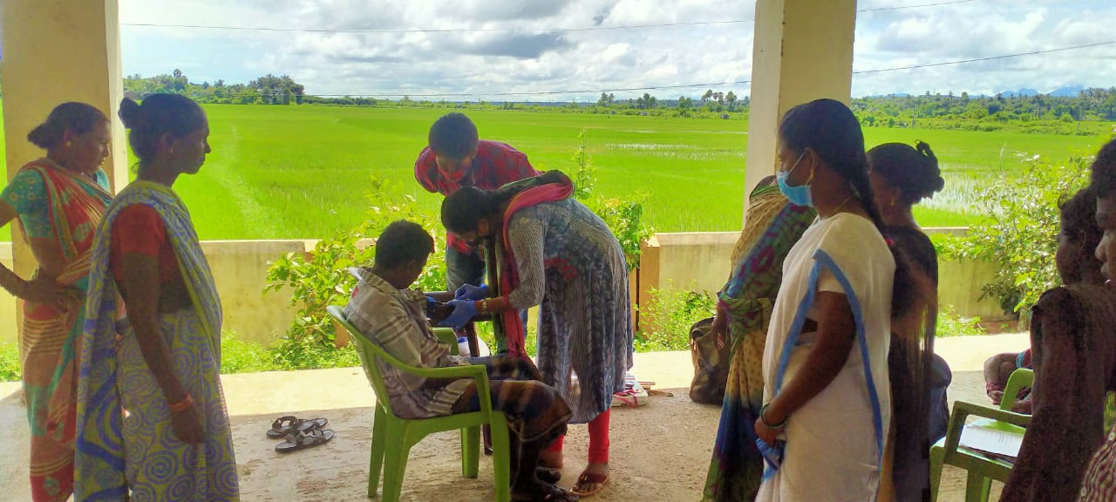
Ongoing Projects
“Anthropometric, socioeconomic, behavioural and genetic study of Uddanam chronic kidney disease (CKDu).”
37 Lakhs, Funded by ICMR
“Cultural and socioeconomic impact of chronic kidney disease in Uddanam area of Srikakulam District, AP”.
45 Lakhs, Funded by ICMR
Collecting the demographic data
Collection of blood samples

Slide 6
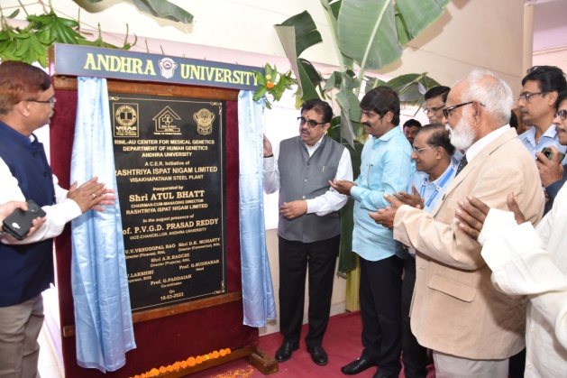
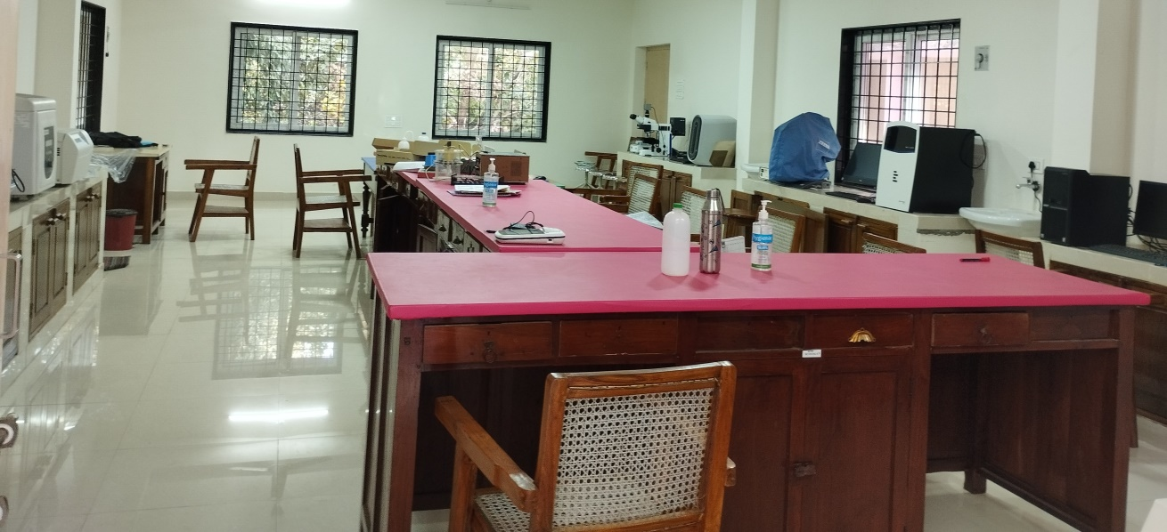
“Bio Arbor AU-RINL Center for Medical Genetics"
Recently, “Bio Arbor – A Center For Medical Genetics” has been established with a collaborative effort of Vizag Steel Plant and Andhra University.
Inaugurated on 18th March 2023

Slide 7
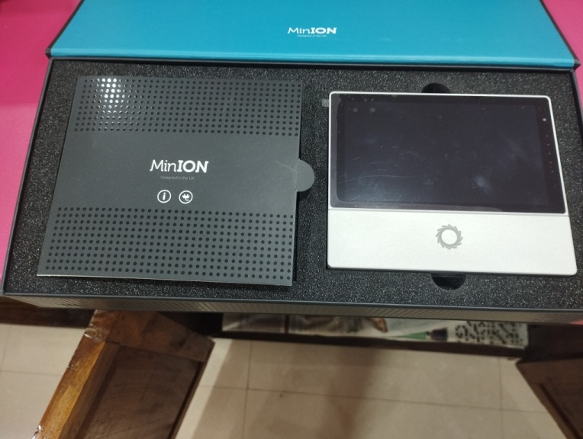
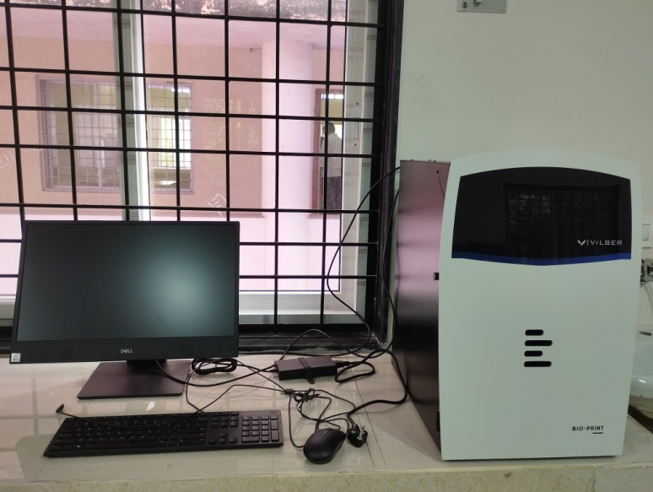
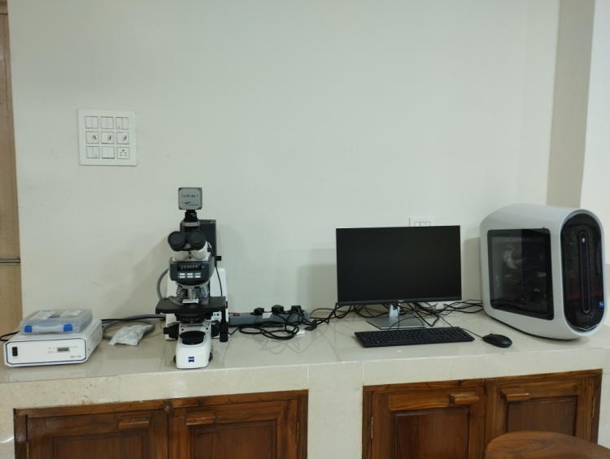
Gel Documentation System (Vilber)
MinIon Sequencer (Oxford Nanopore)
Carl-Ziess Microscope with iKaros software

Slide 8
Curricular Aspects
The curriculum has been recently modified based on NEP, following Outcome based framework (OBE) with continuous teaching and learning strategies.
Planning course outcomes, educational objectives, assessment tools, implementation and quality improvements based on student feed backs is the norm followed in the Department.

Slide 9
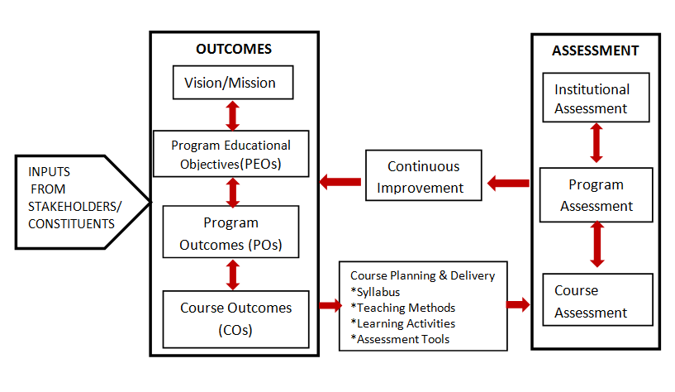
Outcome-Based Education Framework

Slide 10
Programs offered
PG Program
M.Sc
Doctoral Program
Ph.D

Slide 11
Courses offered
I SEMESTER | III SEMESTER
1.1 - Basic Human Genetics 1.2 - Population Genetics and Biostatistics 1.3 - Human Cytogenetics 1.4 - Molecular Genetics | 3.1 - Genetic Toxicology and Cancer Genetics 3.2 - Genetic Engineering 3.3 - Genetic Screening and Counseling, Gene Therapy 3.4 - Genomics, Proteomics and Bioinformatics MOOC’s Course I Intellectual Property Rights
II SEMESTER | IV SEMESTER
2.1- Cell Biology and System Physiology 2.2- Human Biochemical and Immunogenetics 2.3 - Medical Genetics 2.4- Diagnostic Molecular Pathology | 4.1 - Dissertation Based on Project Work 4.2 - Comprehensive Viva-voce MOOC’s Course II Research Methodology

Slide 12
Program Outcomes
PO1. The Human Genetics department aims to develop competent and committed students with advanced level of communicative skills.
PO2. The department endeavours for continuous upgradation and dissemination of knowledge, creating and developing highly adaptable skills for suitable employment.
PO3. The department inspires uncompromising commitments to teaching and to develop practical oriented facilities.
PO4. To develop a full-fledged computer lab with biostatistics and bioinformatics software.
PO5. To impart moral values of professional ethics in students guiding them to be responsible citizens for a better society.
PO6. The students gain fundamental knowledge on different branches of Human Genetics.
PO7. Understand the different modes of inheritance patterns like simple single factor inheritance (Mendelian inheritance), polygenic inheritance, multifactorial inheritance, and mitochondrial inheritance of various genetic diseases, calculating the risk of the diseases and offering genetic counselling.
PO8. Gain practical knowledge and skills in laboratory techniques in basic genetics, cytogenetics, biochemical genetics, immuno genetics, molecular genetics, and bioinformatics.
Students will gain a comprehensive understanding of Genetics and its applications, preparing them for research, healthcare, and biotechnology roles.

Slide 13
As per NEP 2020, Department is focusing on multi disciplinary areas through MOOCs courses offered by SWAYAM and NPTEL.
MOOCs Courses
Bio medical Nanotechnology
Computer aided drug designing
Genome editing and engineering
Health research fundamentals
Basics of Mental health and Clinical psychiatry
Drug Discovery: Principles and Engineering

Slide 14
Courses with Employability/Skill development
Bioinformatics
Human Cytogenetics
Diagnostic Molecular Pathology
Genetic Engineering
Genetic Screening and Counseling
Value added courses
Intellectual Property Rights
Research Methodology
Notes:
xzcdszvc

Slide 15
Course outcomes
PAPER 1.1- BASIC HUMAN GENETICS
CO1: To introduce the students the main concepts of basics of Human Genetics.
CO2: To enhance knowledge towards the Mendels laws of inheritance and extension of Mendelism.
CO3: To study the gene interactions, modifying genes, polygenic inheritance and multifactorial inheritance.
CO4: To know the construction of human pedigree, modes of inheritance and mitochondrial inheritance.
CO5: To have better understanding about the linkage and crossing over, genetic and physical mapping.

Slide 16
CO PO Mapping
Semester-I,Paper-I:BASIC HUMAN GENETICS
CO | PO1 | PO2 | PO3 | PO4 | PO5 | PO6 | PO7 | PO8
CO1 | 2 | 3 | 2 | 2.9 | 2 | 3 | 2 | 2.5
CO2 | 3 | 3 | 2 | 3 | 3 | 2.5 | 3 | 3
CO3 | 3 | 3 | 3 | 3 | 2.5 | 3 | 3 | 3
CO4 | 3 | 3 | 2.7 | 2.5 | 2 | 2.5 | 3 | 3
CO5 | 3 | 3 | 3 | 3 | 3 | 3 | 3 | 3
Action verb/ Keywords Used in Writing Cos | Mapping Level
Keywords/action verb of the Course Outcome is not related to the action verb of Program Outcomes | ‘-’
Part of PO is reflected through keywords/action verbs of CO | ‘1’ (Low)
Major part of PO is reflected through keywords/action verbs and moderate level performance is expected from student to achieve CO | ‘2’ (Medium)
Exact action verb of PO and critical performance expected from student to achieve CO | ‘3’ (High)

Slide 17
PO attainment
2020-2022
2021-2023
PO Attainment level (out of 3)
PO Attainment level (out of 3)
Program Outcomes (POs)
Program Outcomes (POs)

Slide 18
Demand Ratio for M.Sc program
Year | No. of eligible applications received | No. of Students admitted | Demand Ratio
2017-2018 | 2848 | 30 | 1:95
2018-2019 | 3139 | 32 | 1:98
2019-2020 | 3377 | 31 | 1:108
2020-2021 | 2687 | 36 | 1:75
2021-2022 | 2687 | 32 | 1:84

Slide 19
Faculty profile
S. No | Name of the Faculty | Designation
1 | Prof. G. Sudhakar | Professor
2 | Dr. V. Lakshmi | Associate Professor & Head
3 | Prof. V. Lakshmi Kalpana | Professor (Honorary)
4 | Prof. G. Paddaiah | Professor Emeritus (Honorary)
5 | Prof. P. Balakrishna Murty | Professor Emeritus (Honorary)
6 | Dr. D. Udaya Kumar | Assistant Professor ©
7 | Dr. T .Mahankali | Assistant Professor ©
Research Articles = 77
Books = 11
Seminar/Conference attended = 52
Webinar attended = 13
Ph.Ds. guided/awarded = 24

Slide 20
Awards/recognitions/fellowship
Name of the Awardee | Name of the Award/recognition/fellowship | Name of the Awarding Agency with contact details | Year of Award
Prof . G. Sudhakar | Best Researcher Award | Andhra University, Visakhapatnam Presented in 83 & 84 Convocation | 2017
Prof . G. Sudhakar | Dr. Sarvepalli Radha Krishnan Award | Andhra University, Visakhapatnam | 2019
Prof . G. Sudhakar | Fellow | Andhra Pradesh Akademi of Sciences, Amaravati | 2019
Prof. V. Lakshmi Kalpana | Associate fellow | AP Akademi of Sciences Amaravati | 2019
Dr. V. Lakshmi | Associate fellow | AP Akademi of Sciences Amaravati | 2019

Slide 21
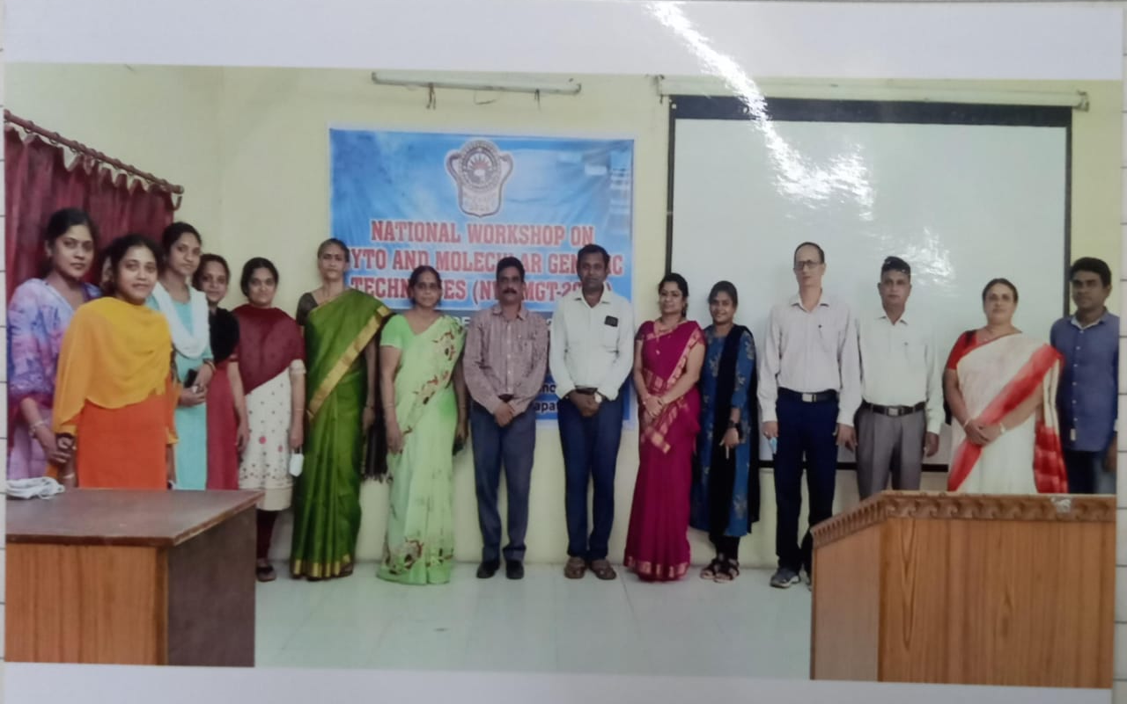
International Webinar and National Workshop
International Webinar on Recent Advances in Human Gentics (RAHG-2021)
National Workshop on Cyto and Molecular Genetic Techniques (NWCMGT-2021)

Slide 22
Number of JRF/SRF/PDF/RA
S.No | Type of Fellowship | 2017-18 | 2018-19 | 2019-20 | 2020-21 | 2021-22
1 | Rajiv Gandhi National Fellowship | 4 | 4 | 4 | 4 | 0
2 | UGC-PDF/DST WOS | 4 | 2 | 2 | 2 | 2
3 | ICMR-RA | 0 | 1 | 1 | 2 | 2
4 | ICMR – Project JRF/SRF | 0 | 0 | 1 | 1 | 1
5 | ICMR-Project Research Assistant | 0 | 0 | 2 | 2 | 4

Slide 23
Student Diversity (Gender)

Slide 24
Student Diversity (Category)

Slide 25
Results analysis

Slide 26
Programs for slow learners
Programs for Advanced learners
Regular monitoring.
The Department has a practice of offering remedial courses for slow learners.
Peer assistance and mentorship.
Encouraging to present papers in Journals/Conferences/Competitions
Guidance for CSIR NET competitive examination
Individual guidance for career building in research and entrepreneurship apart from placements in the campus.
Link to Mentor/ Mentee system reports
Notes:
Mentor-mentee system: It has helped both the quick learners and the slow learners by equipping them with the skills required in completing the program and for the overall personality development through participation and through peer learning.
Remedial classes: Especially for students from rural and marginalized backgrounds. Remedial courses are offered to those deficient in the English language.
LCD, and smart boards: For more engaging and effective teaching and learning process.

Slide 27
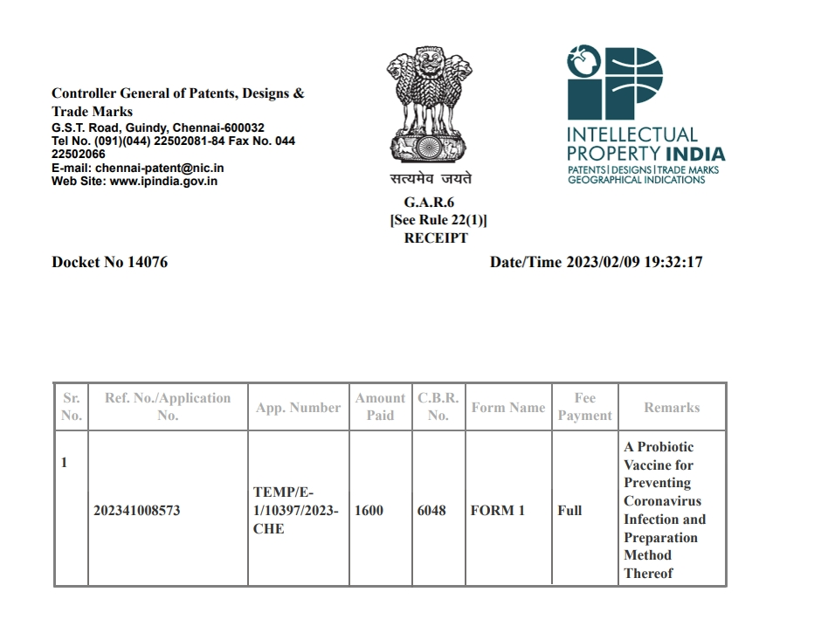
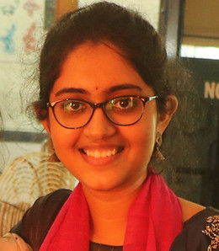
Students in research
Madhuri Vissapragada
Msc (Human Genetics), 2021-23 batch

Slide 28
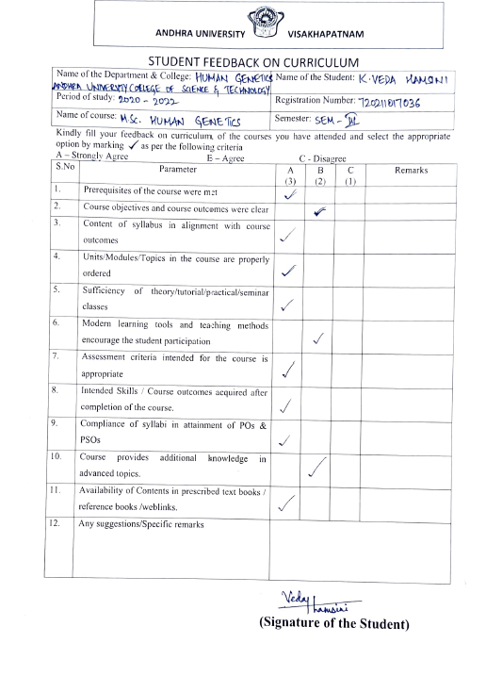
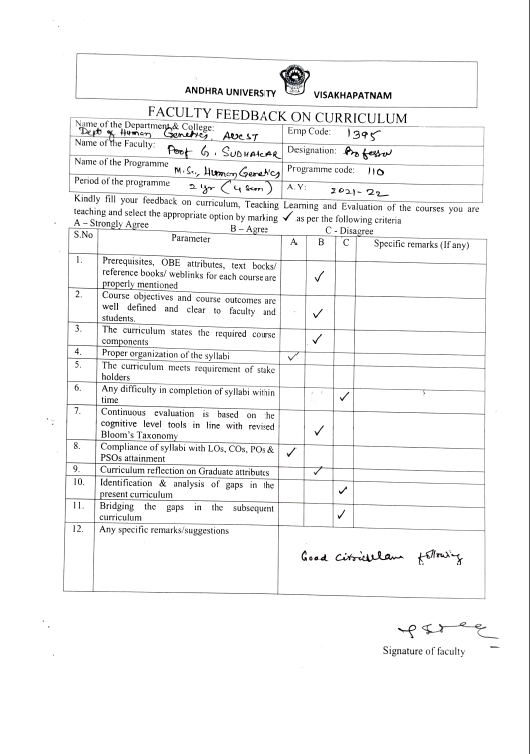
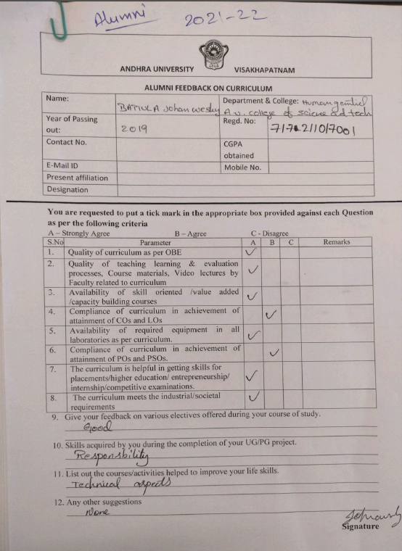
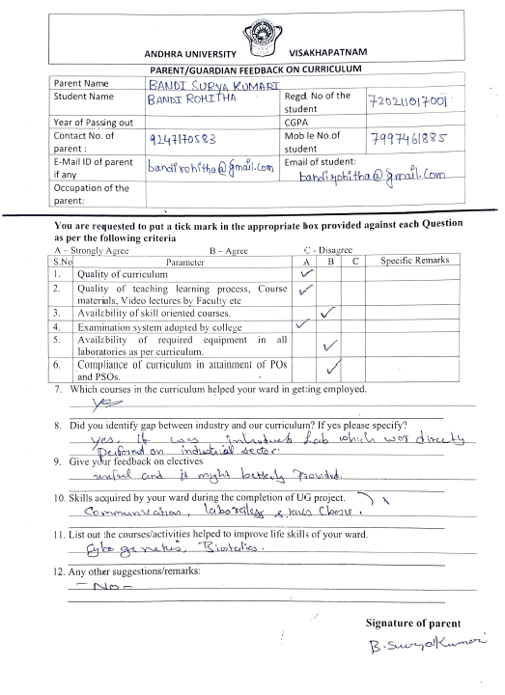
Feedback
Feedback was taken from all stakeholders of the department and the observations are considered for revising the structure of the programs.
Student
Faculty
Alumni
Parent

Slide 29
Facilities available
Laboratories: 6
Class Rooms: 3
Seminar Hall: 1
Library: 1
Computer Lab: 1

Slide 30
Alumni
The alumni of this Department occupy distinguished positions in
Academics & Research

Slide 31
Industry
Start ups
Dr. Kalyani, Director, Shrijoshika Molecular Diagnostics and Research Center

Slide 32
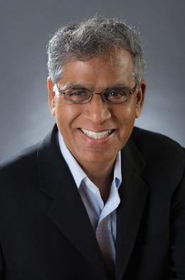
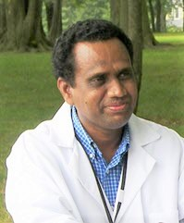
Prominent Alumni
Prof. Suresh K. Alahari
Ph.D
Louisiana State University,
New Orleans, USA
Prof. Undavalli Murthy
Ph.D
Columbia University, New York, USA.
Prof. Govindaiah Vinukonda,
Ph.D
New York Medical College, Valhalla, New York, USA.

Slide 33
Dr. Susan Mathew, Professor and Director, Cytogenetics Laboratory, Weill Cornell Medical College, Cornell University.
Dr. Rajani Ravi, Professor, Department of Oncology, Johns Hopkins Medicine.
Dr. K.N.Mohan, Professor, Department of Biological Sciences, Birla Institute of Technology and Science Pilani – Hyderabad.
Dr. Venkata Subhadra Nandula, Director of Cytogenetics and Associate Director, Molecular Diagnostics at Cancer Genetics, Inc.
Dr. Zeenath Jehan, Genetic Consultant and Scientist, Department of Genomic Medicine, Vasavi Hospital.
Dr. Prahlad Balakrishnan, Med Genome Labs Ltd.
Dr. Anuradha Nalli, Expert Scientific Writer at Novartis.

Slide 34
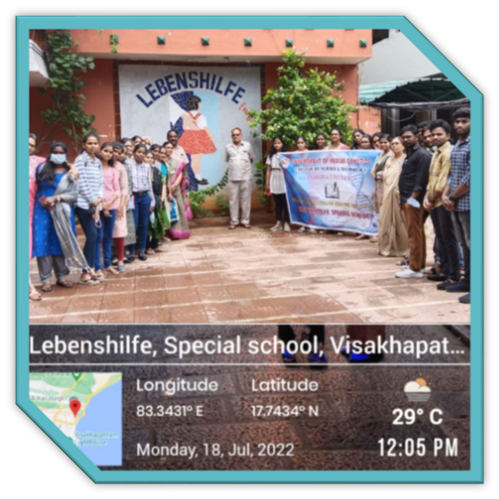
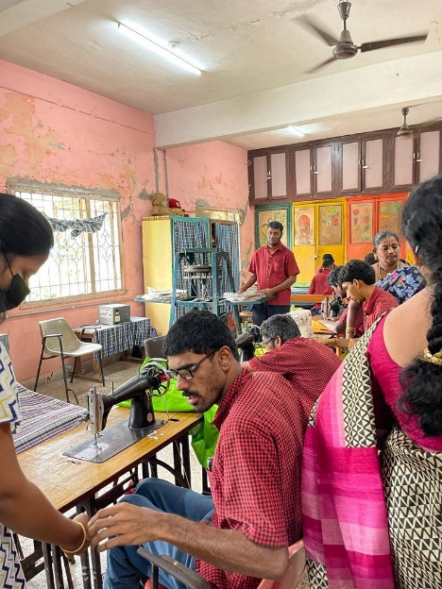
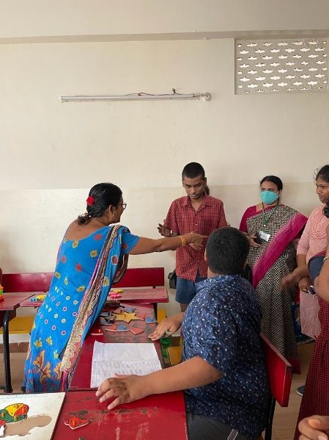
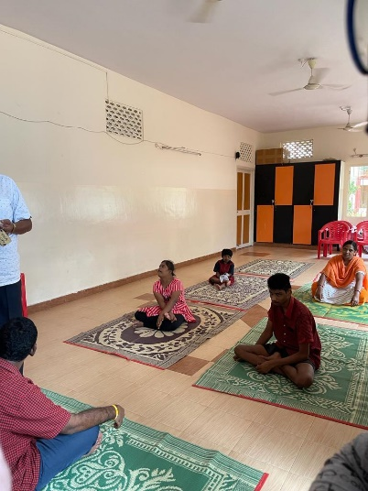
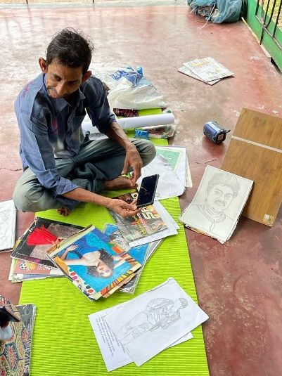
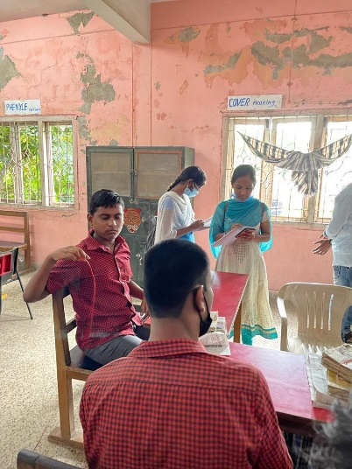
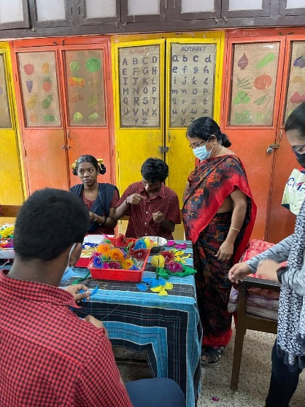
Student Activities
Visit to Lebenshilfe Special School For The Mentally Handicapped, MVP colony, Visakhapatnam

Slide 35
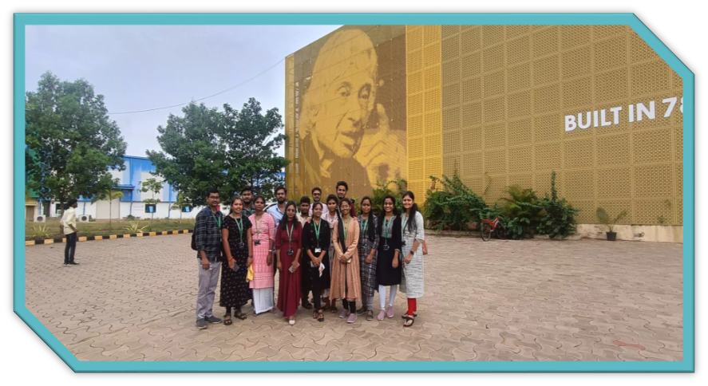
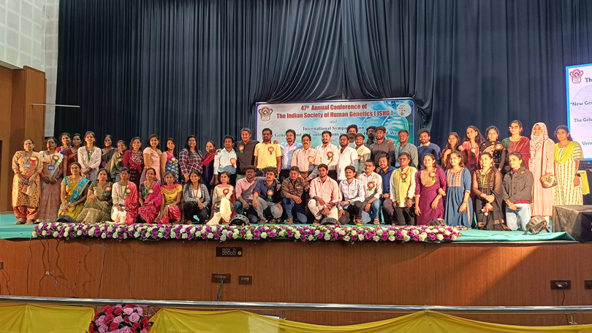
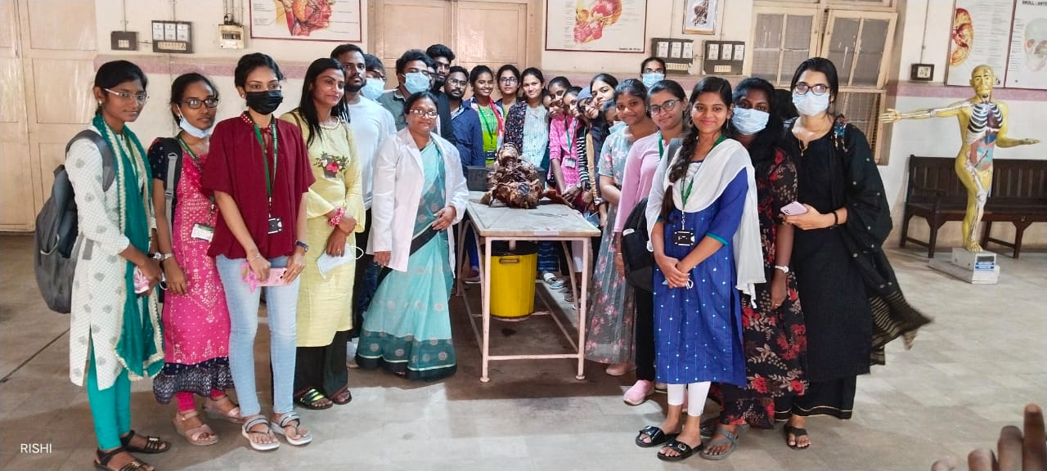
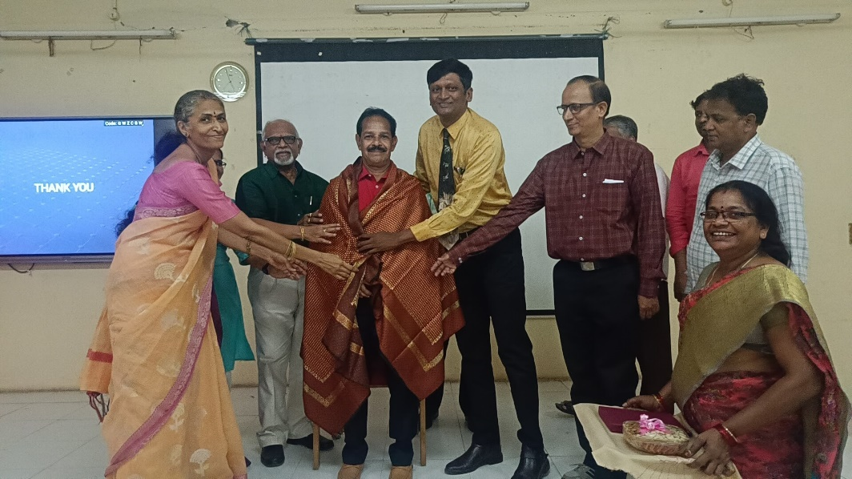
ISHG Conference 2023
Industrial Visit to AMTZ, Vizag
Guest Lecture by Prof M. Sashidhar Bharatidasan University, Tirucharapalli.
Visit to Anatomy Lab, AMC Vizag

Slide 36
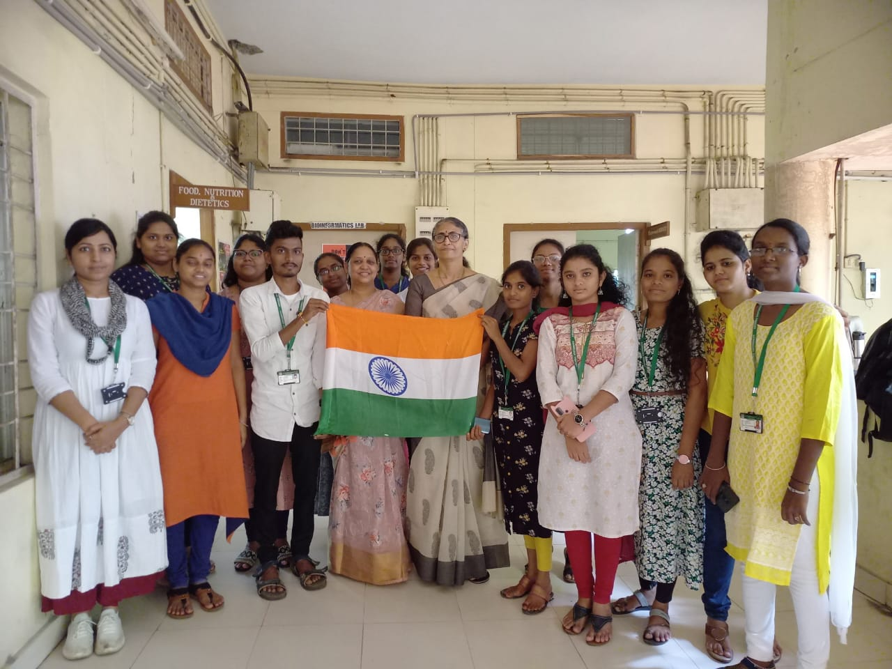
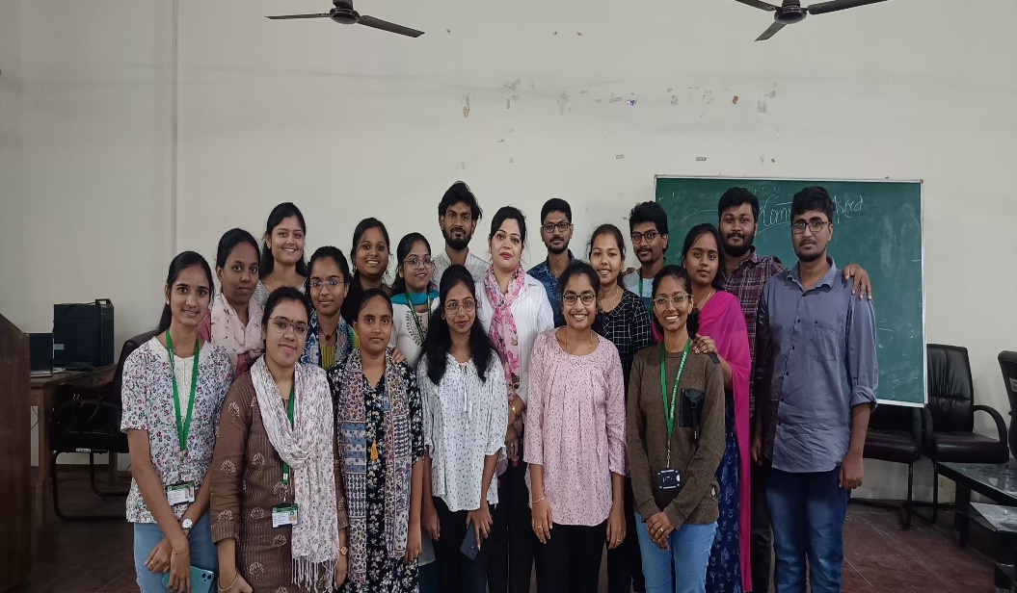
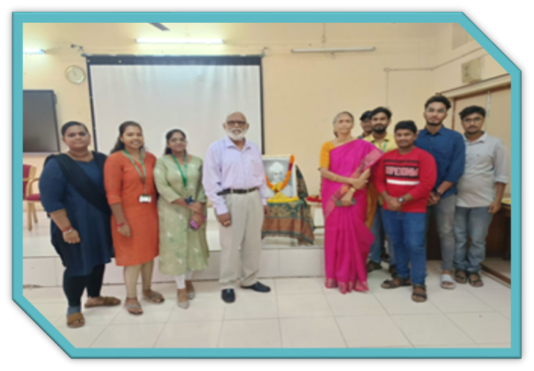
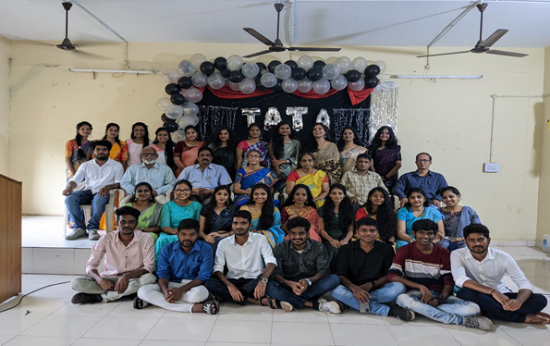
Workshop on Interview skills at Andhra University by Rubicon
Har Ghar Tiranga
Teachers Day Celebration
Farewell celebration

Slide 37
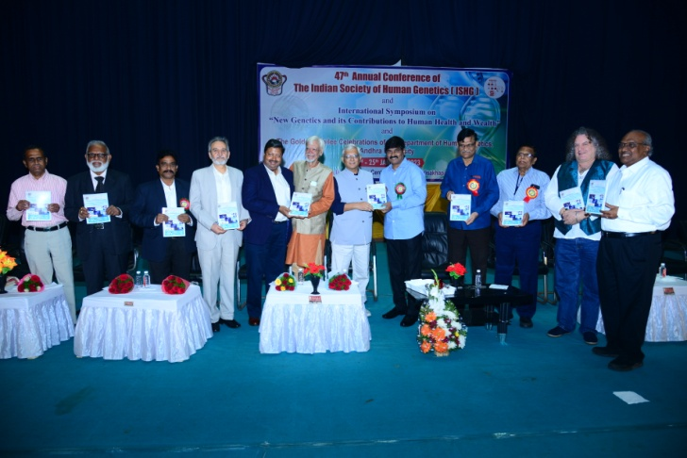
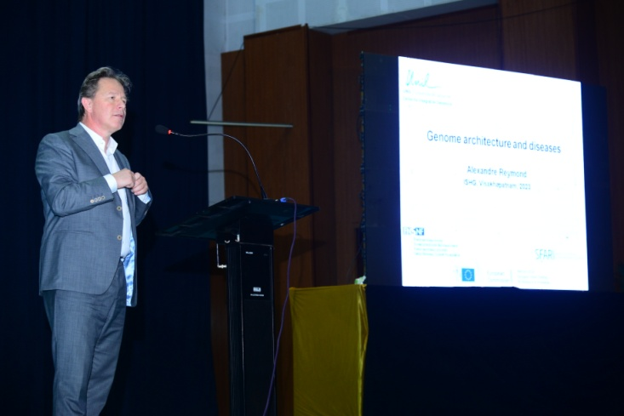
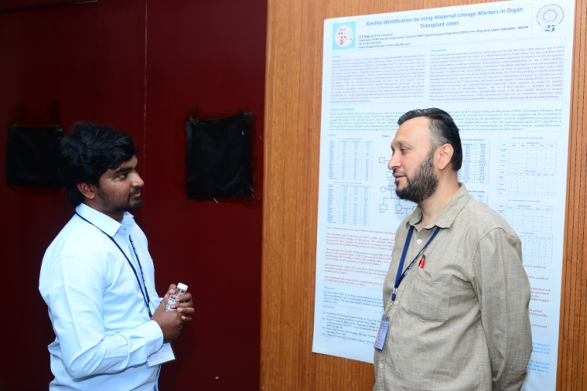
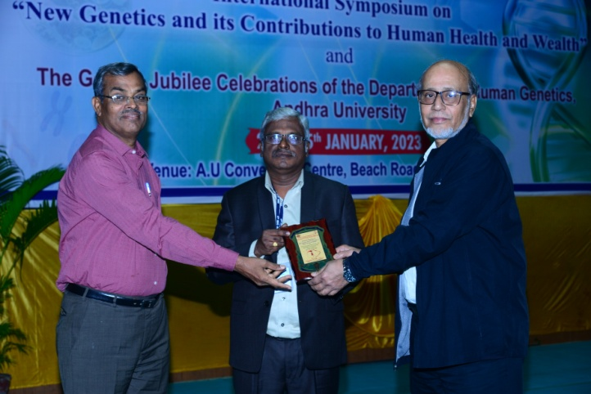
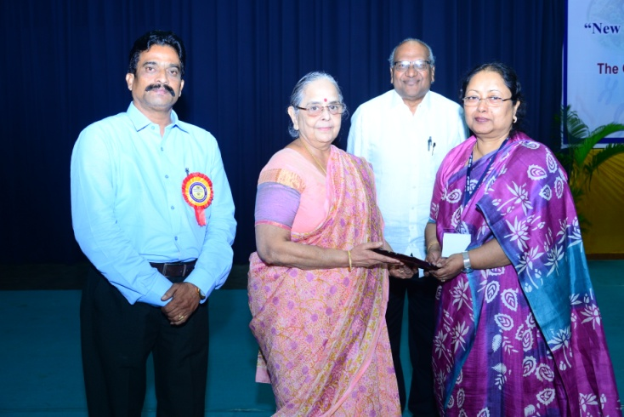
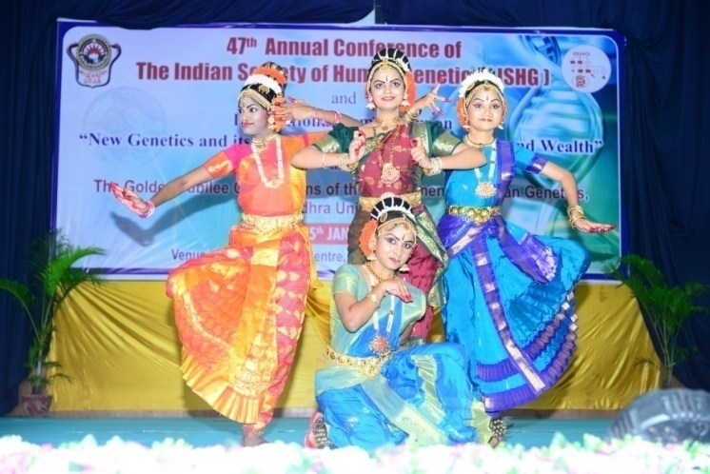
47th Annual conference of Indian Society of Human Genetics (ISHG) & Golden Jubilee celebrations of Department of Human Genetics (23-25 January, 2023)
Notes:
Overseas scientists: 20
Indian Geneticists: 40
Young Scientists: 8
Indian participants: 300.
Participants From Andhra University: 200 students and 100 research Scholars
Total: 700

Slide 38
Awards/Prize for outstanding students
Decennial Celebrations Prize
Prof. Suresh Alahari Gold Medal
Few Initiatives
Incorporation of courses which impart professional ethics and enhanced employability skills in new syllabus (effective from 2023-2024).
Organizing coaching classes to students for national eligibility Tests (NET) like, CSIR-UGC NET, DBT BET, ICMR JRF.

Slide 39
Future plans
In alignment with our vision and mission, we have ambitious future plans to further our impact on genetics education, research, and community healthcare
Expanded Educational Programs: We will develop and expand our genetics curriculum, offering a wider range of educational programs to cater to students at various levels.
Genetic Knowledge Dissemination: We will continue to engage in public outreach and education by organizing genetic awareness campaigns, seminars, and conferences.
Technology and Infrastructure Upgrades: We will invest in state-of-the-art genetic analysis equipment and infrastructure, ensuring that our students and researchers have access to the latest tools and technologies to push the boundaries of genetic research.
Community Genetic Clinics: We aim to establish community genetic clinics in underserved areas, to bridge the gap in healthcare disparities and to ensure equitable access to genetic healthcare services.
By continuously striving for excellence, expanding our educational programs and nurturing collaborations, we are confident that our Department will play a pivotal role in revolutionizing genetic healthcare and improving the lives of countless individuals in our community and beyond.

Slide 40
THANK YOU

